Slide 1

Requirements
Engineering
Notes:
‹#›

Slide 2

Topics
Interesting Facts
About RE
Basics About RE
Phases
Elicitation
Analysis
Validation
Management
Notes:
‹#›

Slide 3
Interesting Facts About RE
Notes:
‹#›

Slide 4
Requirements Engineering
Main Concern: what should the system do?
Main Result: Software Requirements Specification
Description of Desired System Functionality
Notes:
‹#›

Slide 5




Requirements Engineering is Difficult
The hardest single part of building a software system is deciding precisely what to build. No other part [...] is as difficult as establishing the detailed technical requirements, including all the interfaces to people, to machines, and to other software systems. No other part [...] so cripples the resulting system if done wrong. No other part is more difficult to rectify later.
- F. P. Brooks in “No Silver Bullet: Essence and Accidents of Software Engineering

Slide 6
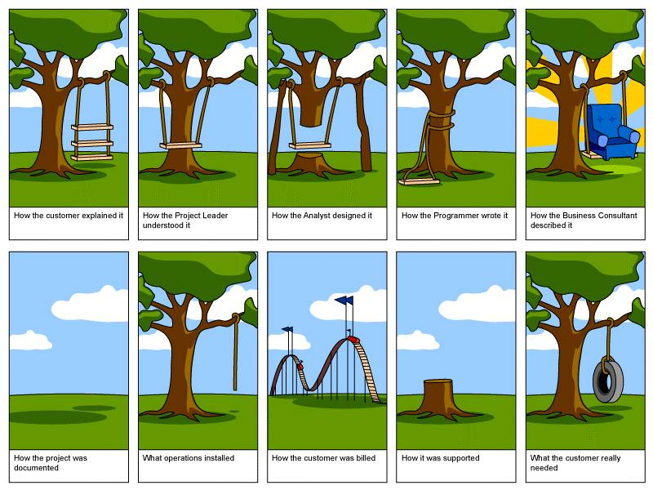
Why Are We Talking RE?
Ever build a swing?

Slide 7
Requirements Engineering is Difficult
Experiment: formal inspection of requirements (10 pgs) for centralized railroad traffic controller
Written by a senior project leader who was experienced in the domain
The author believed that the teams would only find a few errors
Inspected by 10 teams of 4 software engineers each
92 errors, some very serious, were found!
Each team found only 35.5 errors on average!
i.e. they missed 56.5 to be found downstream
Many errors were found by only one team!
Errors of greatest severity found by fewest teams!
More information: J Martin, WT Tsai: N-Fold Inspection: A Requirements Analysis Technique. CACM 33(2): 225-232 (1990).

Slide 8
Requirements Engineering is Difficult
80% of interface faults and 20% of implementation faults due to requirements [Perry & Stieg 1993]
85% of defects due to requirements
49% due to incorrect assumptions
29% due to omitted requirements
13% due to inconsistent requirements [Young 2001]
1.9 faults per page of specifications,
0.9 faults per page of design,
0.3 faults per page of code! [JPL]
54% of all errors found after coding and unit testing
83% due to requirements and design
17% due to coding stage [Boehm]

Slide 9
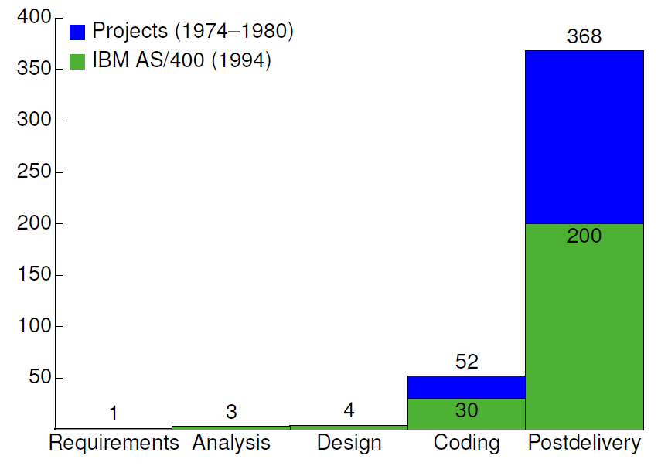
Requirements Errors Are Common, Stubborn, and Expensive!
Requirements errors are more expensive to fix later:
Fixes in requirements can be done in text
Other fixes require
Localization
Change of
Design
Code
Documentation
Test of change itself
System regression test
i.e. they missed 56.5 to be found downstream
Worst case: System Redesign and Redevelopment
1X 5X 10X 50X
[Stecklein 2004]

Slide 10
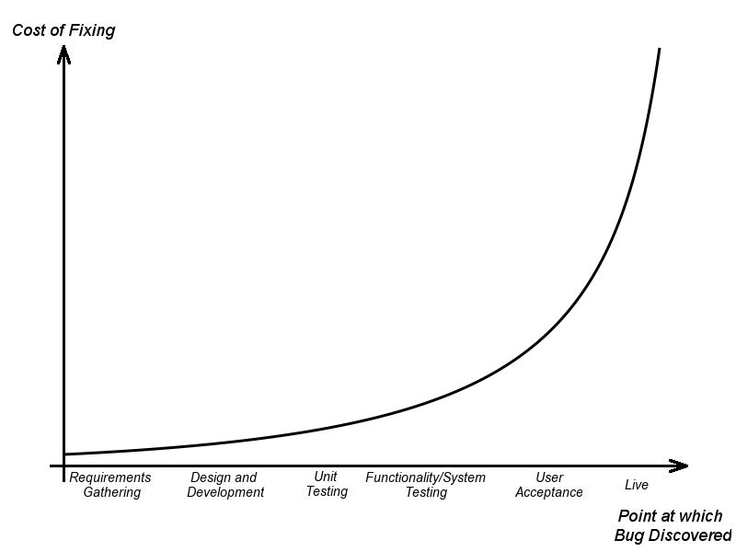
But Seriously…
The classic cost of a requirement defect curve:

Slide 11
Basics About RE
Notes:
‹#›

Slide 12
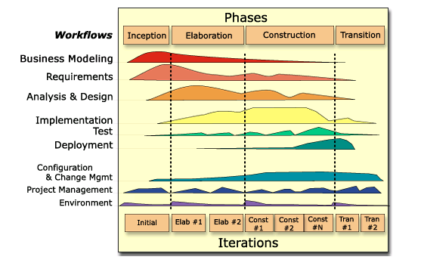
Where Are We?
Requirements errors are more expensive to fix later:
RUP Inception and Elaboration
Workflows related to Requirements Engineering
Business Modeling
Requirements
Analysis
Design
Implementation
Project Management

Slide 13
Requirements Engineering
Some definitions and terms:
The process of establishing the services that the customer requires from a system and the constraints under which it operates and is developed
The requirements themselves are the descriptions of the system services and constraints that are generated during the requirements engineering process
The output of the RE phase serves as inputs to many other process phases

Slide 14
What is a Requirement
A requirement is a description of one service or constraint of the system that the user desires.
Requirements are
…aimed at different audiences:
user requirements vs system requirements
…aimed at different aspects of the system:
functional vs non-functional vs domain
…described with different formalisms:
natural language vs graphical vs formal methods
(it needs to do X vs it needs to run on X)

Slide 15
User Requirements
These are written primarily for system users who do not necessarily have detailed technical knowledge:
Managers & Users (Customer) – to define system
Managers (Contractor) – to plan system development
Developers (Contractor) – to specify system reqs.
Often in natural language with diagrams to support or elaborate
Often complemented with rationales to help developers understand:
The application domain
Why the requirement is stated in its current form
Possible effects of requirements changes
Also called the requirement definition

Slide 16
User Requirements - Example
Requirement 1 - The web-based library information system shall allow users to search books and audio-visual materials through a catalogue page.
Is this a good (well written) requirement?
Source:
I. Sommerville: Software Engineering, 8th ed., 2006.

Slide 17
User Requirements - Example
Requirement 1 - The web-based library information system shall allow users to search books and audio-visual materials through a catalogue page.
Part of System Design (or a non-functional requirement)
How do you search? Author? Title? Keywords? Full Text?
Needs refinement
Which catalogue?
Source:
I. Sommerville: Software Engineering, 8th ed., 2006.

Slide 18
User Requirements - Fixed Example
1. The library information system shall allow users to search the library catalogue for books and audio-visual materials.
Rationale: Allowing users to find books and AV-materials through the information systems saves both users’ and librarians’ time.
1.1 The library information system shall allow users to search using any combination of the following fields:
1.1.1 Author
1.1.2 Title
1.1.3 Publication year
1.2 The search shall return a book or audio-visual material if its library catalogue entry exactly matches each of the fields specified by the user (see 1.1).

Slide 19
System Requirements
These are written primarily for system developers as starting point for design
They are structured document setting out detailed, technical descriptions of the system services
Adds detail to the user requirements
Should be consistent with them
Sometimes also used as a contract between client and contractor
Tension between precision and detail (for design) and openness (for contracting)

Slide 20
System Requirement Example
User Requirement
System Requirements
1. The software shall provide a means of representing and accessing external files created by other tools.
1.1 The user should be provided with facilities to define the type of external files.
1.2 Each external file type may have an associated tool which may be applied to the file.
1.3 Each external file type may be represented as a specific icon on the user’s display.
1.4 Facilities should be provided for the icon representing an external file type of be defined by the user.
...

Slide 21
Functional Requirements
A functional requirement defines a function of the system or one of its components
These are:
How the system should respond to particular inputs
How the system should react in particular situations
May also state what the system should not do
Ideally: each line of code can be traced to a functional requirement

Slide 22
Non-Functional Requirements
A non-functional requirement imposes constraints on the design or the implementation.
Typically these are cross-cutting or emergent properties:
They affect whole system: where do you implement usability or reliability?
They can be difficult to meet...
... but failure can render entire system useless!

Slide 23
Non-Functional Requirements
Non-functional requirements can also constrain the -
Process: How the system is developed
“The system shall be implemented in Java SE8.”
“The system development shall follow the rules in DO-178B.”
Environment: Hardware, software, legal concerns
“The system shall run on mobile devices with at least 16GB RAM that run Android KitKat 4.4.4.”
“The system shall not disclose to the operators of the system any personal information about customers apart from their name and reference number.”

Slide 24
Phases
Elicitation
Analysis
Verification Management
Notes:
‹#›

Slide 25
Common Phase Activities
Requirements Elicitation
Requirements Analysis
Requirements Validation
Requirements (Change) Management

Slide 26
Elicitation
Notes:
‹#›

Slide 27
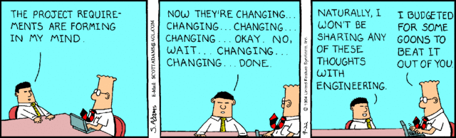
Requirements Elicitation
Requirements are in general not just “discovered” or “gathered”...
... but must be “elicited”!

Slide 28
Requirements Elicitation Techniques
There are a wide variety of approaches and techniques:
Observational: Observe users of existing system
Ethnographic methods
Analytical: Analyze documents, forms, processes
Domain analysis
Inquisitive: Interview users
Role playing
Speculative: Suggest and evaluate functionality
Brainstorming
Rapid prototyping
Usually several methods must be applied.

Slide 29
Requirements Elicitation
Sometimes called discovery or gathering
Involves the technical staff working with customers to find out about the application domain, the services that the system should provide and the system’s operational constraints
May involve
End-users
Managers
Engineers involved in maintenance
Domain experts
Trade unions
🡺These are all called Stakeholders

Slide 30
Requirements Elicitation
(Just some of the) Problems of eliciting requirements
Stakeholders don’t know what they really want
Stakeholders express requirements in their own terms
Different stakeholders may have conflicting requirements
Organisational and political factors may influence the system requirements
The requirements change during the analysis process. New stakeholders may emerge and the business environment change

Slide 31
Analysis
Notes:
‹#›

Slide 32

Requirements Analysis
How do we take requirements, expressed as the needs of a software system in a domain, and translate them into software products?
Requirements Analysis is a collection of activities whose objective is to provide a communicative model to bridge the chasm between business stakeholders and implementers.
Warning: Many methodologies do not recognize the value of analysis!
Creates artifacts not directly deliverable to the customer
Analyses and designs rapidly fall out of synch with code
Analysis loses information in translation
Analysis paralysis a real problem
Requirements
Code

Slide 33
Example: Use Case Analysis
Use cases can be used to derive initial requirements. These will:
Identify actors as a subset of the stakeholders
Not all stakeholders actually interact with the system
Identify all ways each actor uses the system
Identify similar uses by different actors
Restructure use cases by generalization, extension, inclusion
Define the system boundary

Slide 34
Validation
Notes:
‹#›

Slide 35
Requirements Validation
Validation is demonstrating that the requirements define the system that the customer really wants
Costs from errors in the requirements are high
Fixing a requirements error after delivery may cost up to 100 times the cost of fixing an implementation error
During validation, these questions must be revisited:
Does each describe something the customer needs?
Are they correct?
Are they consistent?
Are they complete?
Are they realistic?
Are they verifiable?
Are they traceable?

Slide 36
Requirements Validation Techniques
Goal: Check the requirements for realism, consistency, and completeness
Prototyping
Use executable system models to check requirements
Requirements reviews
Systematic manual analysis of the requirements.
Test-case generation
Develop tests for requirements to check testability: “If you can’t test it, it is not a requirement!”

Slide 37
Management
Notes:
‹#›

Slide 38
Requirements Management
Change is a Risk!
The priority of requirements from different viewpoints changes during the development process
System customers may specify requirements from a business perspective that conflict with end-user requirements
The business and technical environment of the system changes during its development
Requirements Management is a process for managing change to the requirements
Should apply to all proposed changes to the requirements
Principal Stages:
Problem analysis - Discuss requirements problems and propose changes
Change analysis and costing - Assess the effects of change on other requirements
Change implementation - Modify requirements document and other documents to reflect changes

Slide 39
Requirements Management Planning
During the requirements engineering process, you have to plan:
Requirements identification
How requirements are individually identified
A change management process
The process followed when analysing a potential requirements change
Traceability policies
The amount of information about requirements relationships that is maintained
CASE tool support
The tool support required to help manage requirements change

Slide 40
Summary
Requirements should capture what a system shall do
… but avoid design detail as much as possible
Written in the user’s language (with all the problems…)
Requirements are difficult to find out and formalize
Requirements problems are
Common
The most costly
The most difficult to correct (they are conceptual)
Use a standard structure, forms, and checklists for the document and the individual requirements
Write verifiable requirements (this means they can be tested!)

Slide 41
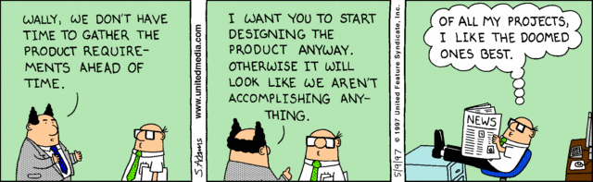
Summary
Poor requirements are the source of all evil!

